Slide 1
March, 2018
ASP.NET CORE
Ihnat Klimchuk

Slide 2
Hi there.
I’m Ihnat Klimchuk
Department: D3 G2
Technologies: .NET, JS, HTML, CSS, SQL, Memes
Software Engineer
Contact Information:
Phone: +375 29 148 43 71
Email: ihnat.klimchuk@itechart-group.com
Skype: ignatks47

Slide 3
Plan
ASP.NET ✔
History ✔
Basics ✔
ASP.NET CORE
Changes
ASP.NET CORE Common Tasks
Tasks and solutions in examples

Slide 4
LECTURE CONVENTION
Lectures will be split in logical parts
You can should ask question after each logical part during special slide
Questions should be somehow connected to ASP
We can afford breaks

Slide 5
ASP.NET CORE
Deep Dive

Slide 6
HISTORY
2014 – Microsoft's new CEO
2014 – Great changes and announcements
2014 – Introducing .NET Core
2016 – Announcing ASP.NET Core 1.0
Notes:
Talk about changes in company

Slide 7
What is .Net CORE
.NET Core is a free and open-source managed software framework for Windows, MacOS and Linux.

Slide 8
What is ASP.Net CORE
ASP.NET Core is a cross-platform, high-performance, open-source framework for building modern, cloud-based, Internet-connected applications.

Slide 9
REASONS
New .NET Core
Large amount of legacy code
Cross platform solution
Tooling that simplifies modern web development
Open-source and community-focused
Lightweight, high-performance, and modular HTTP request pipeline
Notes:
Reasons for new ASP.NET CORE

Slide 10
Questions
Feel free to ask anything

Slide 11
TOOLS
Visual Studio
.NET Core
Brains

Slide 12
ASP.NET CORE in nutshell
CODE SNIPPET
using Microsoft.AspNetCore;
using Microsoft.AspNetCore.Hosting;
using Microsoft.AspNetCore.Http;
namespace MinimalAspNetCoreApp
{
public class Program
{
static void Main()
{
WebHost
.Start(c => c.Response.WriteAsync("Hello World!"))
.WaitForShutdown();
}
}
}
Notes:
That is short and working sample - easy

Slide 13
ASP.NET CORE fundamentals
Application startup
Dependency injection
Middleware
Static files
Multiple environments
Configuration and options
Logging
MVC
Others
Notes:
We are going through this points

Slide 14
Entry Point
CODE SNIPPET
public class Program
{
public static void Main(string[] args)
{
BuildWebHost(args).Run();
}
public static IWebHost BuildWebHost(string[] args) {
return WebHost.CreateDefaultBuilder(args)
.UseStartup<Startup>()
.Build();
}
}
Notes:
That is default entry point sample Explain what it is

Slide 15
Startup
CODE SNIPPET
public class Startup
{
public void ConfigureServices(IServiceCollection services)
{
//... add services to the container
}
public void Configure(IApplicationBuilder app)
{
//... configure the HTTP request pipeline
}
}
Notes:
Explain this 2 functions
Important!

Slide 16
What is Dependency injection
Dependency injection (DI) is a technique for achieving loose coupling between objects and their collaborators, or dependencies. Rather than directly instantiating collaborators, or using static references.
Notes:
Talk about IoC and DI

Slide 17
Dependency injection
CODE SNIPPET
public void ConfigureServices(IServiceCollection services)
{
//Extension that add MVC services
services.AddMvc();
//Adding ErrorDescriber that will be new each time
services.AddTransient<IErrorDescriber, ErrorDescriber>();
//Adding EmailSender that will be same object per request
services.AddScoped<IEmailSender, EmailSender>();
//Adding SmsSender that will be same object per app
services.AddSingleton<ISmsSender, SmsSender>();
}
Notes:
Configuring services sample

Slide 18
Dependency injection
CODE SNIPPET
public class HomeController : Controller
{
private readonly IErrorDescriber errorDescriber;
public HomeController(IErrorDescriber errorDescriber)
{
this.errorDescriber = errorDescriber;
}
//Implementation
}
Notes:
How configuring working with DI

Slide 19
Middleware
Middleware1
Middleware2
Middleware3
Notes:
Middleware based solution
Explain why

Slide 20
Middleware
CODE SNIPPET
public void Configure(IApplicationBuilder app)
{
//Serving static files
app.UseStaticFiles();
//If it’s not static file request
//Perform authentication
app.UseAuthentication();
//Let’s find a right controller for request
app.UseMvcWithDefaultRoute();
}
Notes:
Configuring pipeline

Slide 21
Questions
Feel free to ask anything

Slide 22
Static files
CODE SNIPPET
public void Configure(IApplicationBuilder app)
{
//Serving static files (for wwwroot folder)
app.UseStaticFiles();
//Serving static files (for MyStaticFiles folder)
app.UseStaticFiles(new StaticFileOptions
{
FileProvider = new PhysicalFileProvider(
Path.Combine(Directory.GetCurrentDirectory(), "MyStaticFiles")),
RequestPath = "/StaticFiles"
});
}
Notes:
Static files example

Slide 23
Environments
CODE SNIPPET
public void Configure(
IApplicationBuilder app,
IHostingEnvironment env)
{
if (env.IsDevelopment())
{
app.UseDeveloperExceptionPage();
}
if (env.IsProduction() || env.IsEnvironment("QA2"))
{
app.UseExceptionHandler("/Error");
}
//...
}
Notes:
Working with environmets

Slide 24
COnfiguration
File formats (INI, JSON, and XML)
Command-line arguments
Environment variables
In-memory .NET objects
An encrypted user store
Azure Key Vault
Custom providers (installed or created)
Notes:
Options, settings and so on

Slide 25
COnfiguration
CODE SNIPPET
...
var builder = new WebHostBuilder()
.UseContentRoot(Directory.GetCurrentDirectory())
.ConfigureAppConfiguration((hostingContext, config) =>
{
config.AddJsonFile(
"appsettings.json",
optional: true,
reloadOnChange: true).
.AddJsonFile(
$"appsettings.{env.EnvironmentName}.json", optional: true,
reloadOnChange: true);
}
...

Slide 26
COnfiguration
CODE SNIPPET
public class Startup
{
public IConfiguration Configuration { get; }
public void Configure(IApplicationBuilder app)
{
string myConfig = Configuration["MyConfig"];
var emailSettings = new EmailSettings();
Configuration
.GetSection("App:EmailSettings")
.Bind(emailSettings);
}
}

Slide 27
Logging
CODE SNIPPET
public class HomeController : Controller
{
private readonly ILogger logger;
public HomeController(ILogger<HomeController> logger)
{
this.logger = logger;
this.logger.LogInformation("Controller created");
}
//Implementation
}
Notes:
Logging

Slide 28
Questions
Feel free to ask anything

Slide 29
MVC in ASP.NET CORE
Controller
Model
View
Notes:
Note that pattern is the same as in ASP.NET MVC

Slide 30
MVC in ASP.NET CORE
Almost the same as in ASP.NET
Can be used for server side rendering
Can be used for API
Razor with Tag Helpers
Optional, lightweight and open source
Notes:
Note about Tag Helper

Slide 31
Tag helpers
CODE SNIPPET
@addTagHelper *, Microsoft.AspNetCore.Mvc.TagHelpers
@addTagHelper *, AuthoringTagHelpers
...
<p>
Thank you for confirming your email.
<a asp-controller="Account" asp-action="Login">
Click here to Log in
</a>
</p>

Slide 32
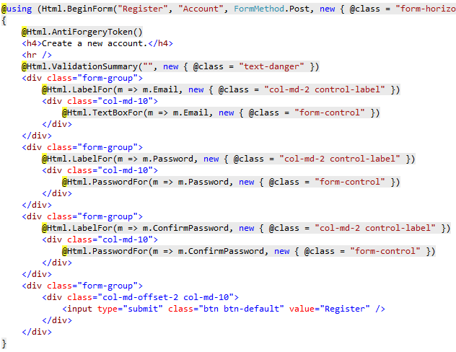
Tag helpers
Notes:
Before

Slide 33
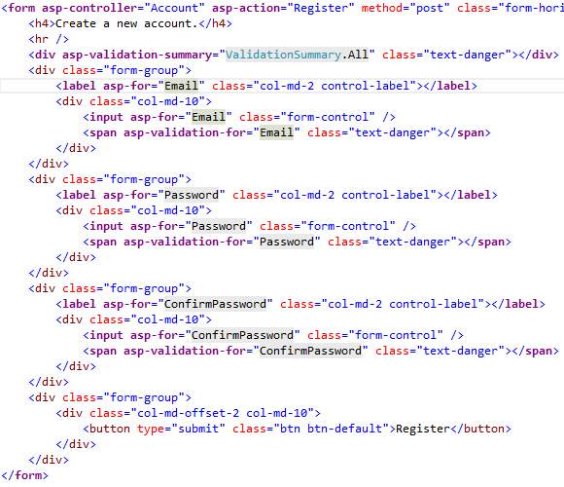
Tag helpers
Notes:
After

Slide 34
Questions
Feel free to ask anything

Slide 35
Client-Side development
NPM (package.json) or Bower (bower.json)
Gulp (gulp.js) or Webpack (webpack.config.js)
TypeScript (tsconfig.json)
LESS or Sass
Others
Notes:
Long talk about frontend

Slide 36
Congratulations! You know ASP.NET CORE!
Not really…
Notes:
Some jokes to say

